Slide 1
Inside Gaia-X #17
Gaia-X Hub Austria, 12.12.2023
Ulrich Ahle | CEO Gaia-X European Association for Data and Cloud

Slide 2

Gaia-X Vision
VISION
Enable trusted decentralised digital ecosystems

Slide 3
Gaia-X Mission
The demand for Data Spaces
STANDARDIZATION
Bilateral data exchange:
one-to-one
Closed community data sharing:
few-to-few
Decentralized and dynamic data ecosystem: many-to-many
Market Adoption
Source: Data Spaces Business Alliance
Notes:
09:41-09:42 Ulrich
Explaining the Mission Statement of how the Gaia-X ecosystem is addressing these challenges.

Slide 4




The existing Split X Model
Disjoint Data & Infrastructures Ecosystems
Data Ecosystem
Data
Untapped, fragmented, disjoint, no secure exchange mechanism
Infrastructures
Segregated, non-reversible, non-interoperable, closed architectures, private standards
Network/ Interconn. Providers
CSP
(e.g. Regional,
specialized, Hyperscalers)
HPC
Sector specific
(e.g. research…)
clouds
EDGE
Infrastructure Ecosystem

Slide 5

Gaia-X Mission
MISSION
Creating the de facto standard aligned with EU values by developing a set of policies, rules, specifications and a verification framework

Slide 6
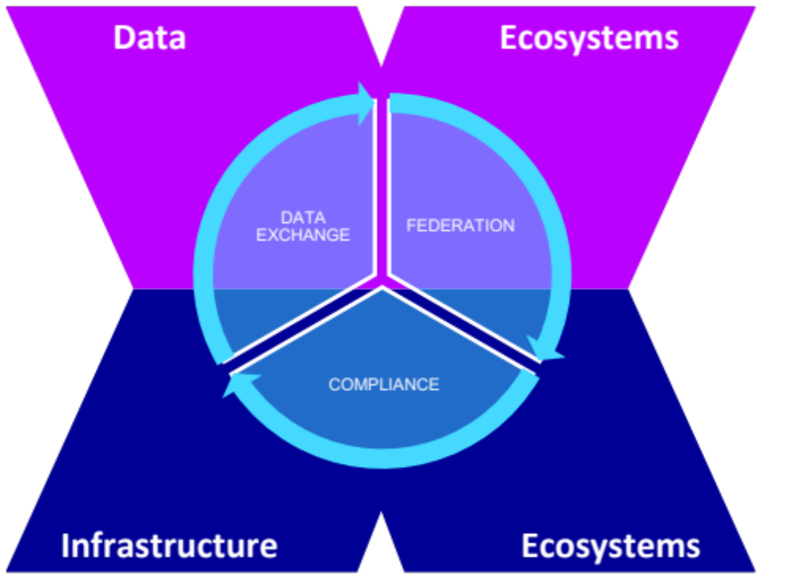





Gaia-X Mission
Gaia-X – Connect Disjoint Ecosystems
Advanced Services
New (Cross-) Sector Innovations / Applications build from service composition.
Data Spaces / Federations
Interoperable & portable (Cross-) Sector data-sets and services.
Data Exchange
Anchored contract rules for access and data usage.
Gaia-X Compliance
Decentralized services to enable objective and measurable trust.
Label framework
Gaia-X and ecosystem specific Labels to ease market adoption through autonomy and self-determination.

Slide 7
Gaia-X Mission
The Gaia-X Strategic Plan in a nutshell
End-user adoption strategy
Market readiness of the technology
Globalisation strategy
Growth of the Gaia-X ecosystem
1
2
3
4
Increase the number of reference stories to enable the community in reference selling
Policymakers supporting and advocating for the Gaia-X initiative in Europe
Work with Cloud Service Providers, including Hyperscalers, while maintaining sovereignty through Gaia-X rules
Establish Hubs in European countries which are not active yet
Intensify collaboration with DSBA and FOSS communities
Strengthen partnership with funded projects on EU and member state level, including lighthouse projects to enhance the functionality
Provide regular deep dive sessions using Gaia-X de-facto standards to demonstrate how Data Spaces based on a federated Cloud infrastructure can be realised
Validate ‘Powered by Gaia-X’
Partner with international members for global regions and align with regulations outside of Europe
Utilize Gaia-X Hubs as multiplier for Gaia-X in their home regions
Include other regions to participate in the definition of labels for their territory
Join global events to increase awareness about Gaia-X
Foster analyst relations to increase global awareness
Demonstrate benefits for existing members
Provide added values for organisations to join Gaia-X
  Large corporates for global reach
  Start-ups and SME for innovative solutions
  Developers and Universities for technology excellence
Maximize the efficiency of the Committees and agile sprints
Grow the number of members
Driven by a growth and service oriented team providing thought leadership to the market

Slide 8
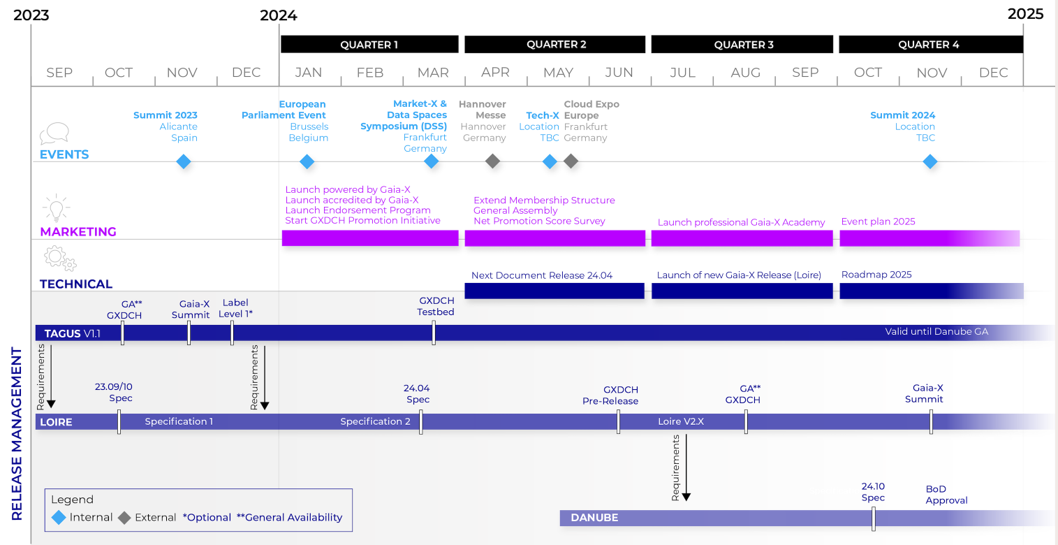
Gaia-X Strategic Roadmap 2024
Notes:
While the Gaia-X Working Group are defining the functional requirements for the Gaia-X architecture, the Gaia-X Lab team works on the implementation and share feedback with the Gaia-X Working Group to improve the specifications.
Our latest release, Tagus, implements the Gaia-X architecture and Gaia-X Policy rules from 2022. This release is based on micro-services, replicated and operated by GXDCH operators. Those micro-services are replicated across the GXDCH deployments and are not in synch which requires additional effort to synchronise their versions across the GXDCH deployments.
The next release, Loire, addresses the previous pain point by introducing a new architecture for the Gaia-X Registry and Credential Event Service services.
As usual, the implementations remain fully free and open-source. Contributions and feedbacks are most welcome. Starting in Q1, early versions of the Loire release will be communicated via our OSS Working Group and our slack channel for a General Availability planned for end of Q2.

Slide 9
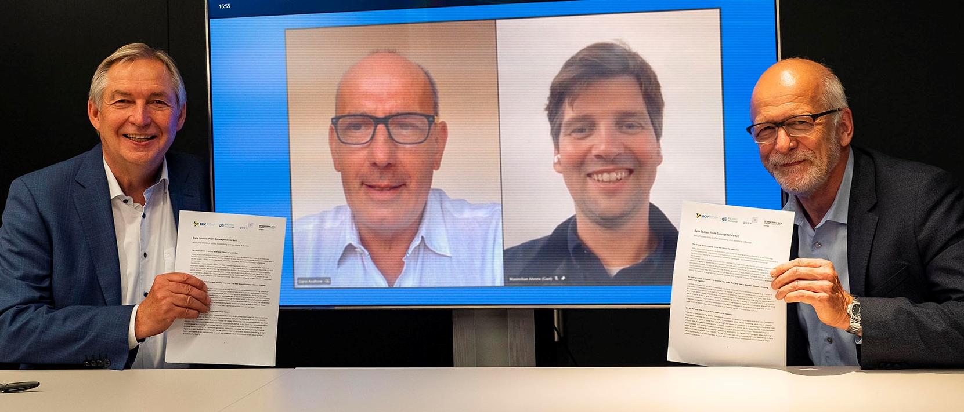
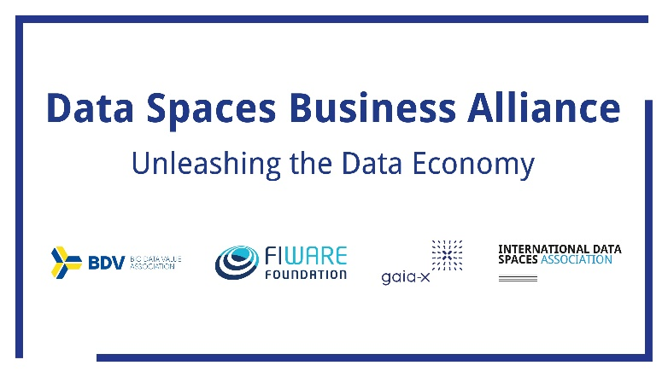
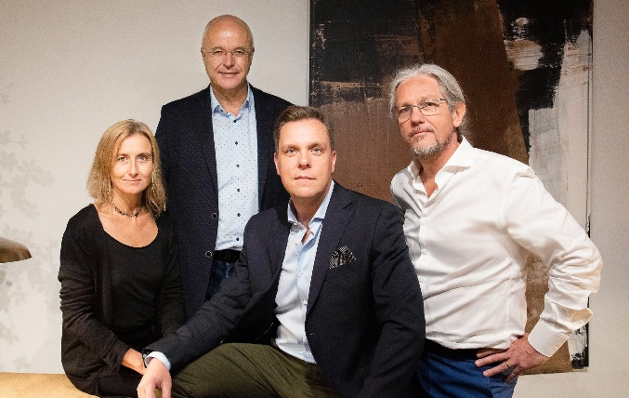
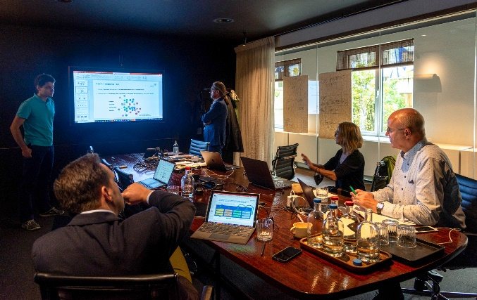
Gaia-X Mission
BDVA, FIWARE, GAIA-X und IDSA created the Data Spaces Business Alliance on September 23rd, 2021
One Architecture
One Voice
One hundred Hubs
One thousand Members
Notes:
09:41-09:42 Ulrich
Explaining the Mission Statement of how the Gaia-X ecosystem is addressing these challenges.

Slide 10
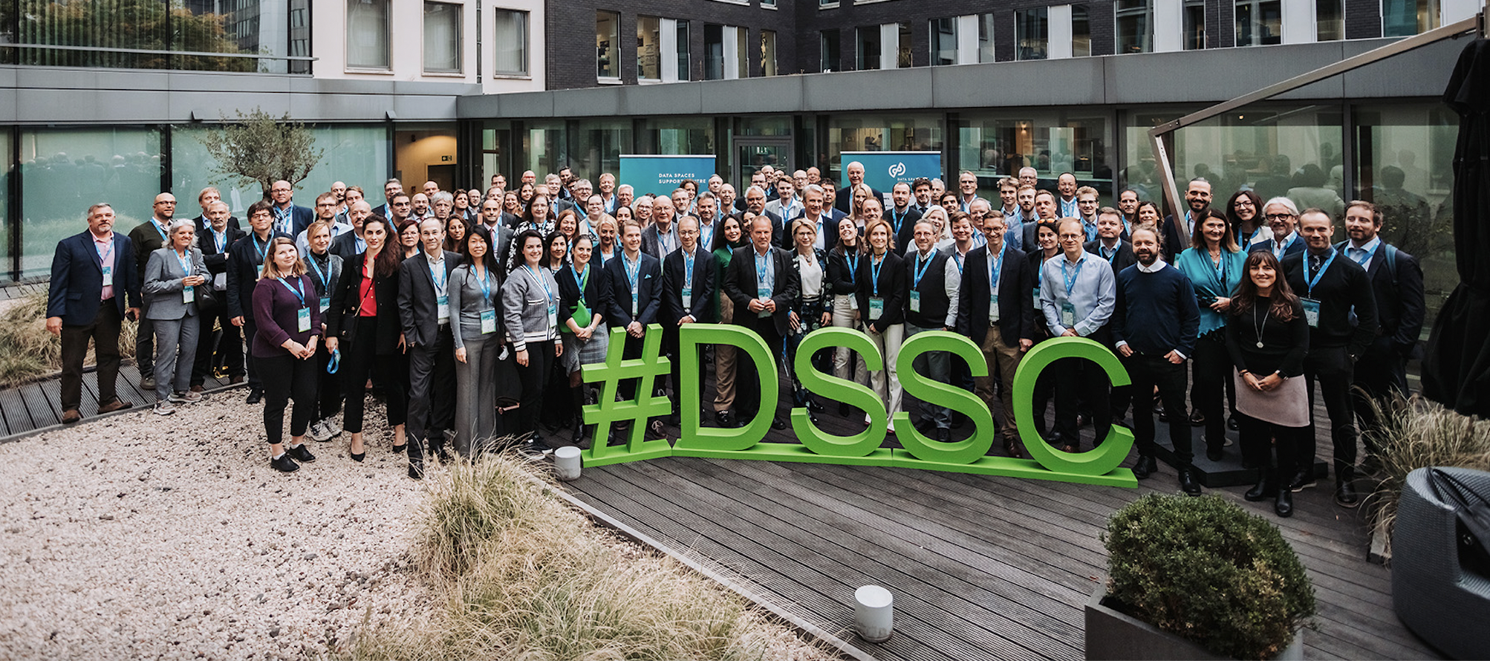
Data Spaces Support Centre: Kick off meeting
Brussels, 13./14.10.2022

Slide 11
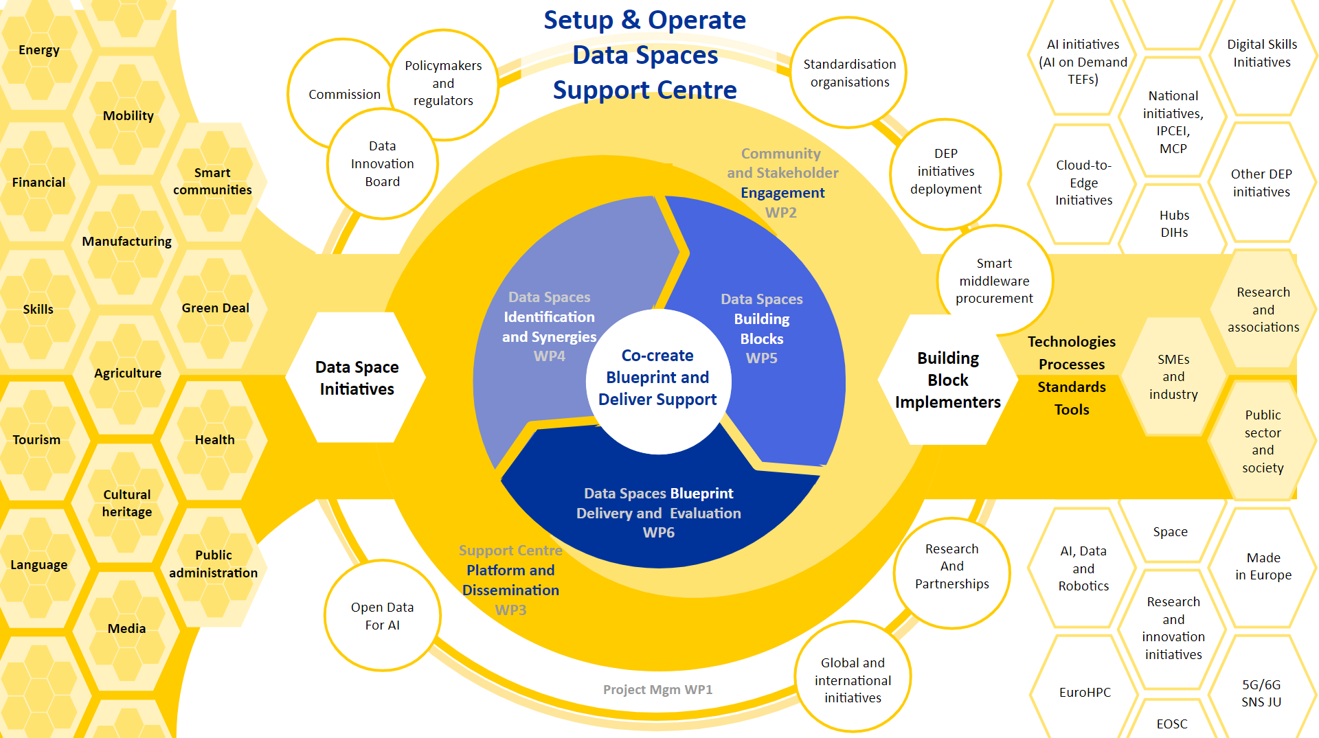

Slide 12
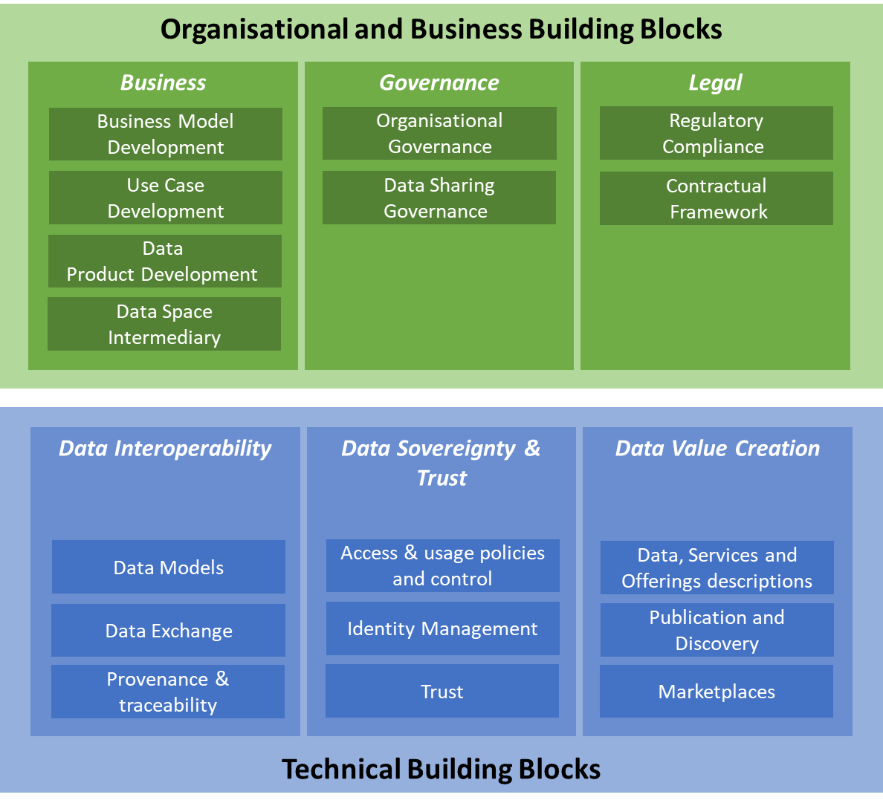
Data Space Building Blocks
*
* source: DSSC blueprint 0.5

Slide 13
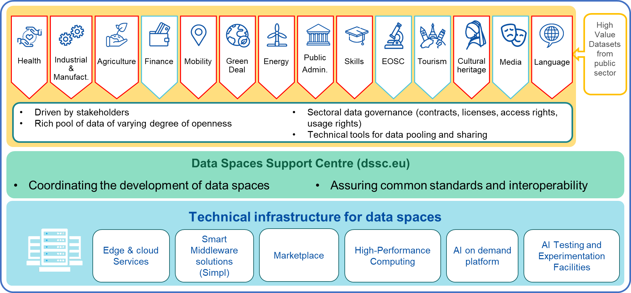
European Data Spaces: The vision
Source:

Slide 14



European Data Spaces: Commission intervention & external stakeholders
Commission funds the creation of common European data spaces in strategic sectors
Alignment with MS initiatives in EDIC
Facilitation through:
Definition of objectives through sectoral policies
Data Spaces Support Centre for coordination & governance
Technical building blocks (a smart middleware) that will pool existing data infrastructures (cloud federation)
SIMPL
Stakeholders
Stakeholders are already organising data spaces in different sectors
The Data Governance Act lays to increase trust in neutral data intermediaries
Source:

Slide 15
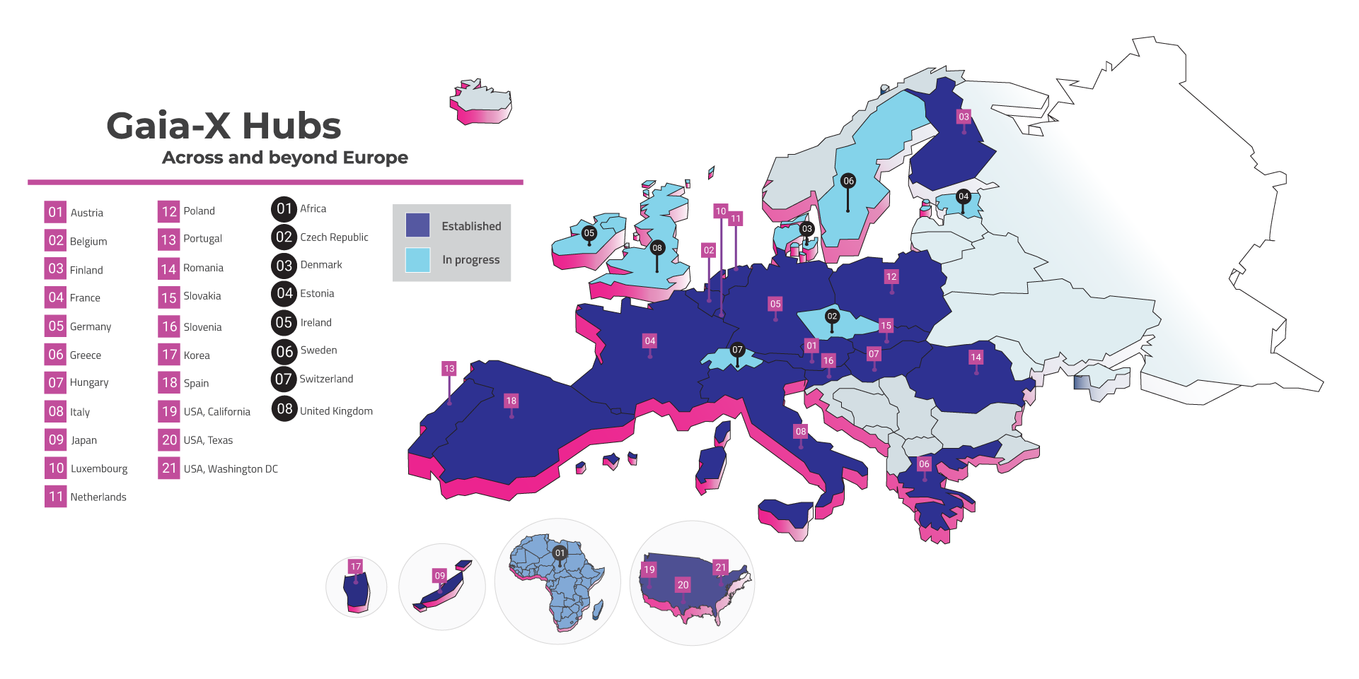
Hub Network Expansion

Slide 16
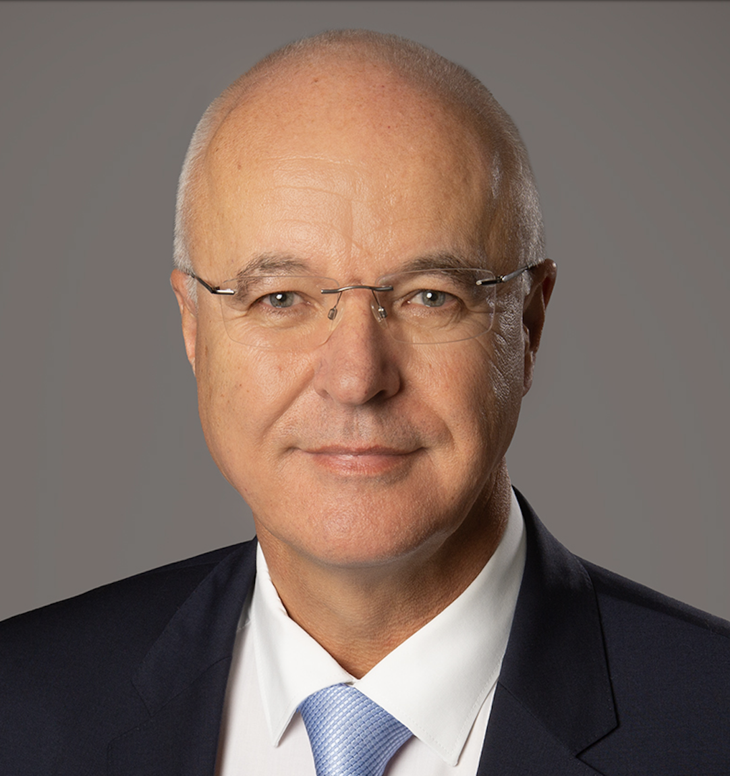
Thank you!
ulrich.ahle@gaia-x.eu
CEO Gaia-X Association

